Slide 1


Project Foodie.com
Presented By: Harika, Aman & Aswin

Slide 2
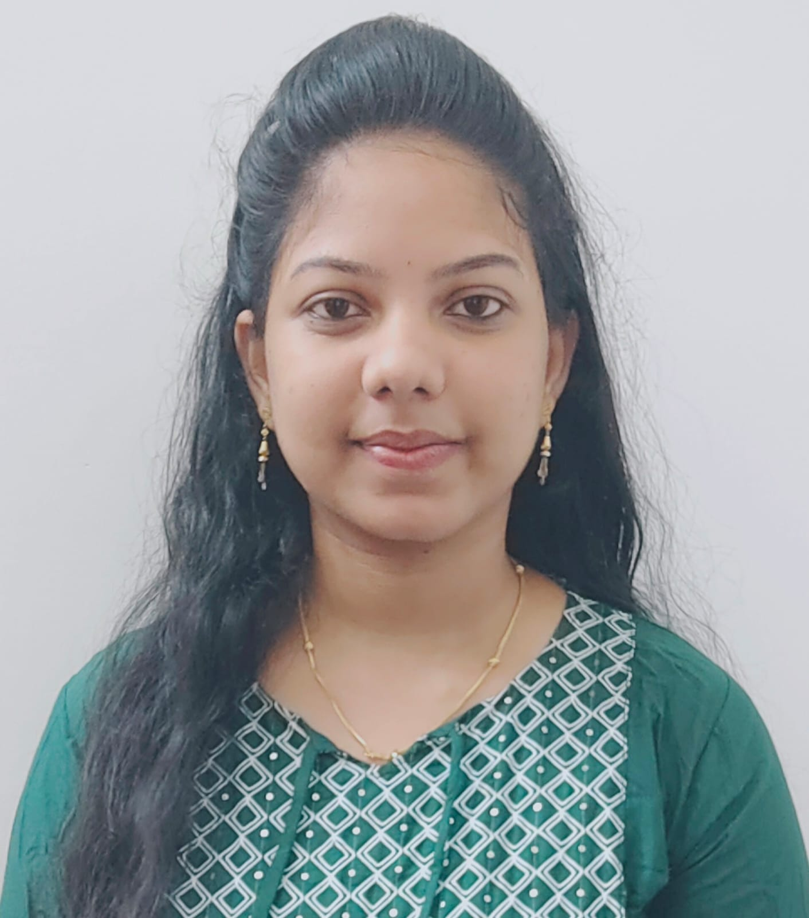
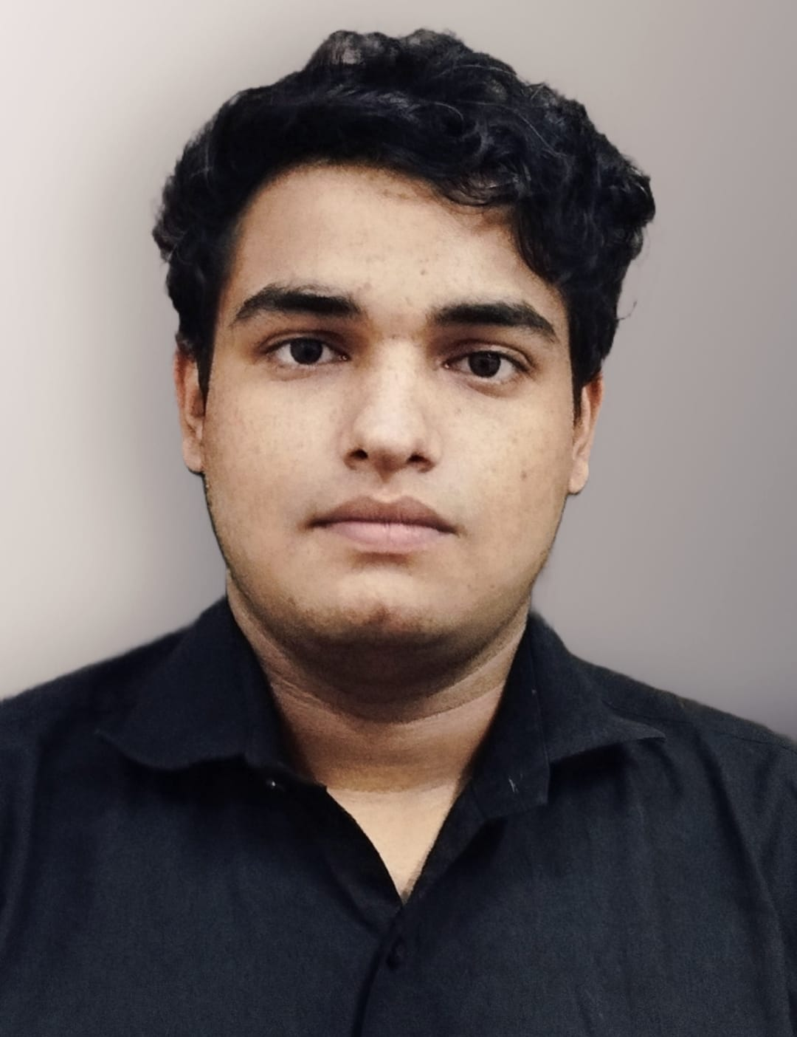

Team
Harika
Aman
Aswin

Slide 3
Need of the project…
Problem : As we move on with the “New Normal” because of the Covid-19 situation. It has forced us to change some of our common behaviours. Enjoying our favourite food at our favourite restaurant is one of them…
At that time the COVID-19 pandemic has highlighted the importance of food delivery platforms in ensuring safety and minimizing contact. These platforms have played a crucial role in supporting social distancing measures by providing contactless delivery options.
Not Only this these platforms also supports small and local restaurant to reach a wider customer base. By ordering through these platforms you are also providing a direct support to these restaurants.

Slide 4
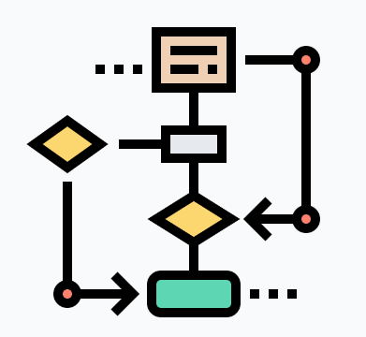






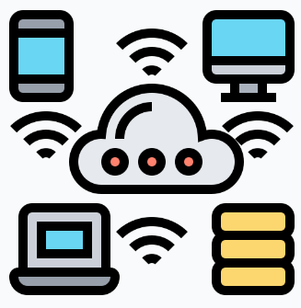
CONTENT
1. Introduction
4. Process Flow
7. Team
2. Features
5. UI Tour
8. Q&A
3. Technology
6. Future Scope

Slide 5
Introduction
Our project is a Food Application “Foodie” a dynamic website inspired by Zomato & Swiggy, The popular food discovery and delivery platform. Our website focuses on revolutionizing the way users explore and order food online. With an extensive restaurant database, detailed menus.
Our main focus is to provide our customer with healthy, hygienic and tasty food. Even our moto is “Your tasty, hot, and hygienic food is just one click away.”
Our Platform facilitates two types of User i.e. Vendor and Customer.

Slide 6
Features
We have tried to provide most of the essential functionalities to our customers and Vendor.
For Login customer and vendor need to go through authentication and validation process
Customer-:
Customer can add items to his favourite section. And from favourites he can Order or can delete that item.
Customer can Order multiple Food items from multiple restaurants.
Customer can also cancel that order.
Customer can View/Update his profile.
For Payment we have provided RazorPay API
Customer can search the item and restaurants
Vendor -:
Vendor can Add/Delete/Update Restaurants in the database.
Vendor can Add/Update Item In his Restaurant.

Slide 7





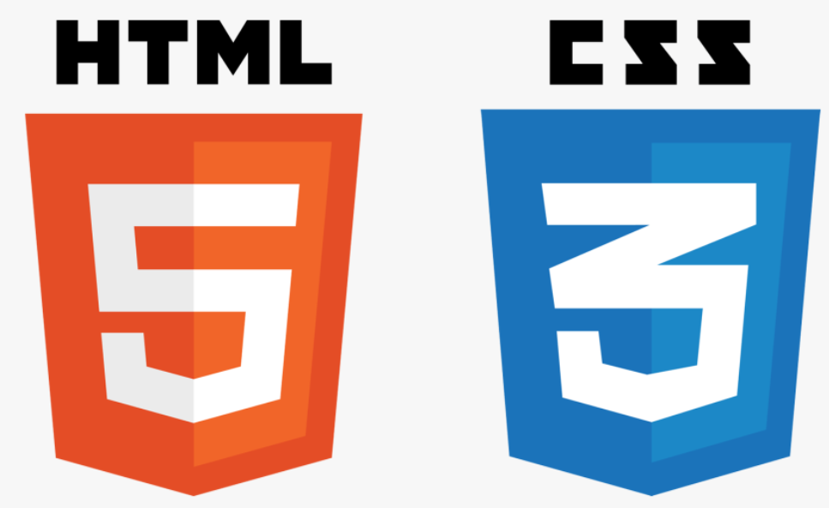




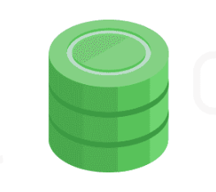





Technology Used In The Project
Spring Data JPA

Slide 8
Architectural Design
Eureka Server
API
G
A
T
E
W
A
Y
Auth Service
Login
Feign Client
Add/Update User
MySql DB
User Service
Angular
Add User
On Successful registration/sending email
Client
Search/add
Restaurant Service
Mongo DB
Order
Order Service
On Cancel order
Notification Service
Payment Service
Synchronous
On Success
Payment Info( RazorPay API)

Slide 9
vendor Flow Process
Add / Update Restaurants
Vendor
Remove Restaurant
Add Item/Menu To Particular Restaurant
Login Page
Vendor Module
Update Item
On Success
Check Profile
Check Role
Update Profile

Slide 10
User Flow Process
View Items/Restaurants
User
Add Items to Cart / Remove
If already Exist / registered
Add Items to Favourites / Remove
Login Page
User Module
View Favourites/Orders
Else Move to registration
Check Profile
On Successful Registration
Registration Page
Update Profile
Payment

Slide 11
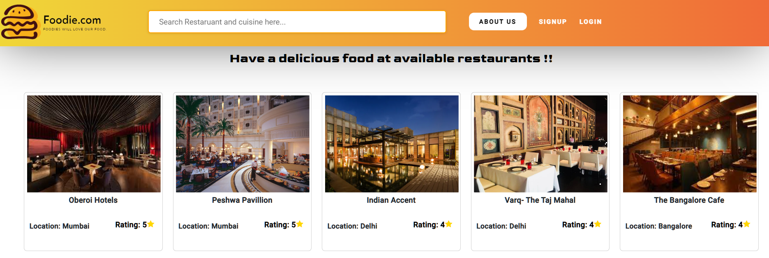
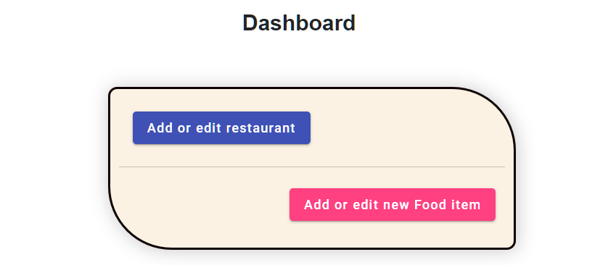
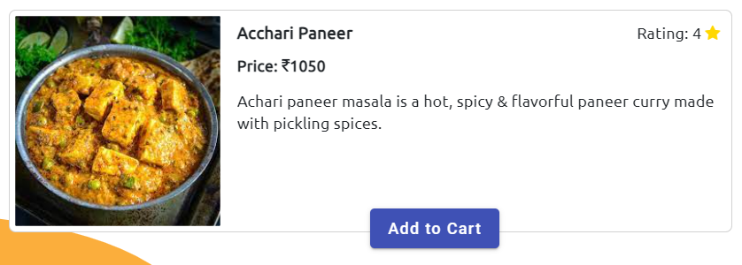
User Experience

Slide 12

Future Scope
In coming time we are Planning to Provide Restaurant location, Using google maps Api and we’ll also try to provide new user a discount on his first order
We’ll also try to implement loyalty program – to encourage customer retention, where user will receive rewards on the basis of orders.
and also social media Integration as well, so if user wants to share something about the items/restaurants, they can share that on social media.

Slide 13

Any Query

Slide 14
Thank you

